Slide 1
Introducing StatLeadGen
Innovative Digital Demand Generation Platform Delivering…
Additional Revenue for Publishers &
Qualified Leads for Advertisers

Slide 2
Publishers
Increase Monthly Revenue by Monetizing any Form on any Website.

Slide 3
Value of StatLeadGenTechnology
No Cost to Implement
Seamless User Experience
Generates Revenue 24/7/365
Automated after Initial Code Implementation

Slide 4
StatLeadGen Overview
Plays Well with Others (supplements current ads)
One-Time Implementation
Affirmative Opt-In
Customization Capabilities
Use Internally to Cross-Promote
Complementary Brands
Events
Webinars

Slide 5
User Flow
Ads only display if a Qualified Match
is detected.
Ads only display after Publisher form is completed.

Slide 6
6 Steps Happen in Milliseconds
Prospect comes to Publisher website & subscribes to magazine, newsletter, webinar, event, etc.
Publisher records form data submitted by Prospect
StatLeadGen analyzes form data
StatLeadGen displays Targeted Ad to Prospect
Prospect chooses to opt-in to Ad (or not)
Prospect finishes on Publisher website

Slide 7
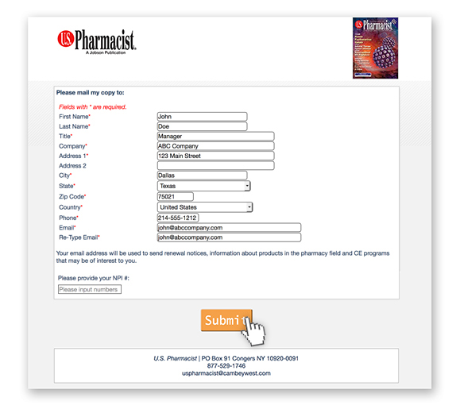
1. Example Subscription Form
Data provided in form is used to match ads.
Data is submitted to publisher.

Slide 8
2. Publisher Records Form Data
Completed Subscription Data is Received and Processed by Publisher.

Slide 9
3. StatLeadGen Analyzes Form Data
1010101
StatLeadGen uses the data submitted on the Publisher Form, to match against the Audience Profile requested by the Advertiser, to display a targeted & relevant ad to the Subscriber.

Slide 10
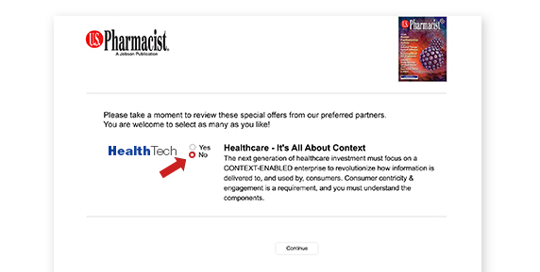
4. Prospect Sees Targeted Ad
Ad is pre-checked ‘No’.
Prospect must affirmatively opt-in by selecting ‘Yes’. If not interested, they simply press ‘Continue’ and return to Publisher Thank You page.

Slide 11
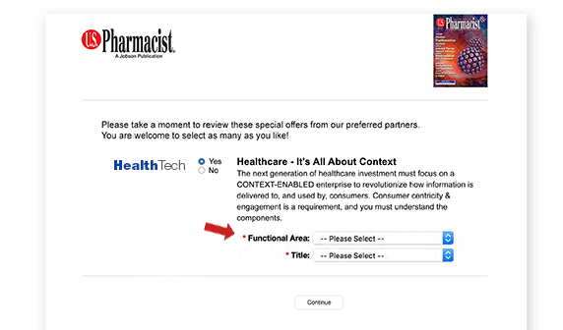
5. Prospect Elects to Opt-In
Additional qualifying questions may appear, if required by Advertiser to further target prospect.

Slide 12
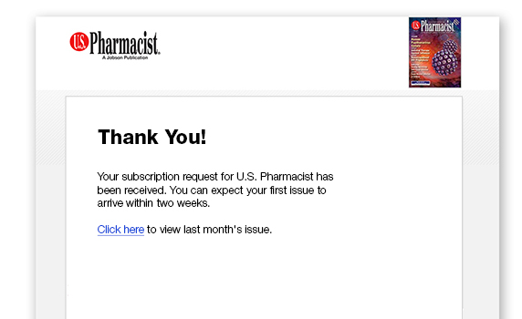
6. Publisher Confirmation Page
Prospect finishes on Publisher website.

Slide 13
Where to Place StatLeadGen Code
Anywhere There is a Web Form or Site Traffic…
Download Whitepaper
Join Mailing List
Log-in
Event Registration
Webinar Sign-up
Gated Content
Renew a Subscription
Newsletter

Slide 14
Publisher Projected Revenue
Determined by 3 Factors
Site Traffic
Number of Pages with LeadFEED Ad Code
Number of Advertisers

Slide 15
Publisher Revenue Example
Registrations x Conversion Rate x CPL = Monthly Revenue
Example: 20,000 registrations x 2% conversion rate x $25 CPL = $10,000
Average Metrics
Conversion Rate: 1.5%-2.5% Cost-Per-Lead: $25-$55 Ads Selected: 2-3

Slide 16
Benefits to Publisher
Generate More Revenue from Advertisers who…
Currently are seeking additional channels, or prospects at different stages of buying cycle.
Currently are not dedicating budget to Publisher for pay-per-lead/action marketing.
Want less risk and more accountability than traditional display ads.
Will only pay for a complete contact record.

Slide 17
Summary
Better position your Digital Advertising solutions…
With StatLeadGen
Flexible & powerful Lead Generation
Platform for growth and change
as Digital Marketing evolves.

